Slide 1

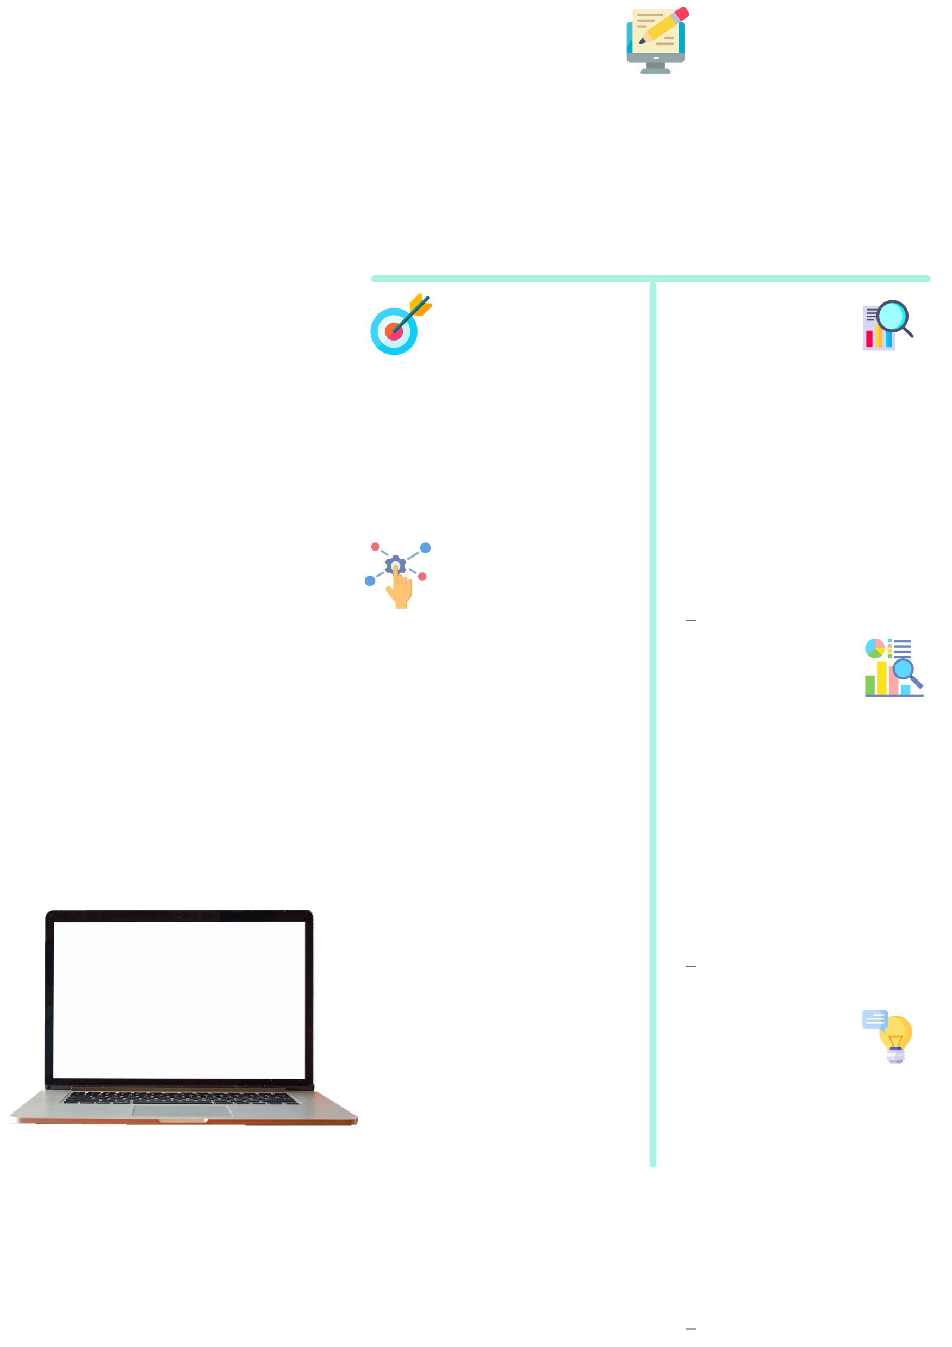



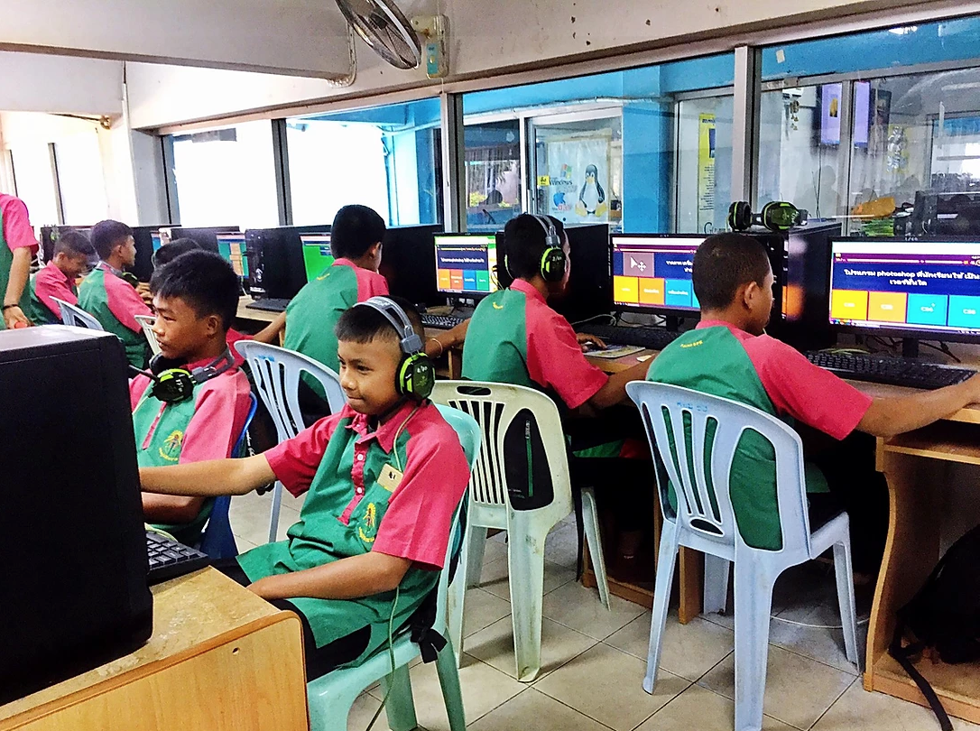
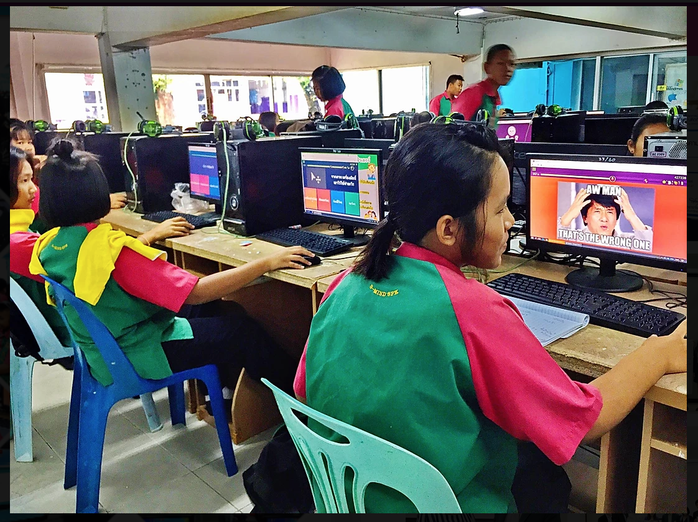

1. ที่มาและความสำคัญ
ที่มาของโครงงาน ......................................................................................................................................................................................................................
จุดประสงค์การทำโครงงาน ......................................................................................................................................................................................................................
เนื้อหาวิชา ........................................................
ประโยชน์ที่คาดว่าจะได้รับ......................................................................................................................................................................................................................
โครงงานคณิตศาสตร์
2. เอกสารที่เกี่ยวข้อง
4. ผลการดำเนินงาน
................................................................................................................................................................................................................................................................................................................................................................................................................................................................................
....................................................................................................................................................................................................................................................................................................................................................................................................................................................................................................................................................................................................................................................................................
นางสาว.......................
ตำแหน่ง ครู วิทยฐานะ -
3. วิธีดำเนินการโครงงาน
โรงเรียนวัดคลองขวาง(จรูญชนม์ราษฎร์บำรุง)
................................................................................................................................................................................................................................................................................................................................................................................................................................................................................................................................................................................................................................................................................................................................................................................................................................................................................................................................................................................................................................................................................................................................................................................................................................................................................
5. สรุปและอภิปรายผล
เรื่อง การพัฒนาบทเรียนแบบผสมผสาน
ตามแนวโซเชียลคอนสตรัคติวิสต์
.........................................................................................................................................................................................................................................................................................................................................................................................................................................................................................................................................................................................................................................................................................................................................................................................................................................................
โดยใช้เทคนิคการเรียนรู้แบบปัญหาเป็นฐาน
เพื่อส่งเสริมทักษะความคิดสร้างสรรค์
สำหรับนักเรียนชั้นมัธยมศึกษาปีที่ 2
6. ข้อเสนอแนะ
..............................................................................................................................................................................................................................................................................

